Slide 1

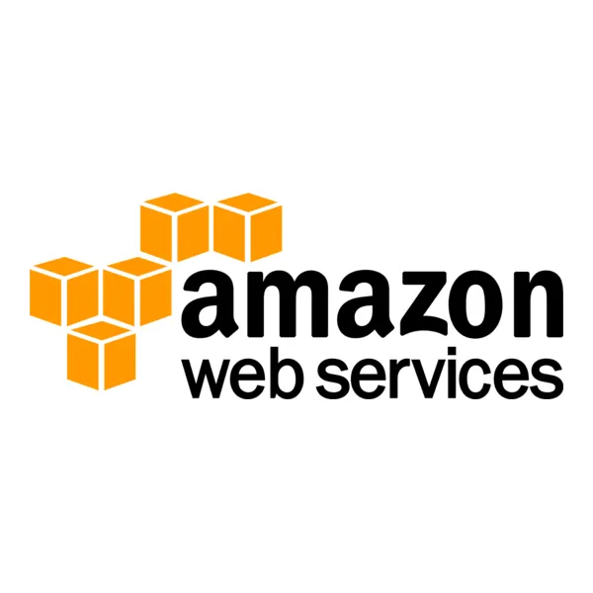
AWS
Threat Detection and Automated Prevention Management
PG-Diploma in IT Infra-structure & System Security
Anuja Bhosale Palak Bhosale Rashi Singh Sakshi Singh Shubham Taru
240840123008
240840123013
240840123043
240840123047
240840123055

Slide 2


PG-Diploma in IT Infra-structure & System Security
Problem Statement
With the increasing complexity of cloud environments, securing AWS infrastructure is a growing concern. Identifying and mitigating threats in real-time is essential to prevent security breaches. This project focuses on using AWS GuardDuty for threat detection and automating remediation using AWS Lambda and CloudWatch Events.

Slide 3

PG-Diploma in IT Infra-structure & System Security
Introduction
AWS GuardDuty is a managed threat detection service that continuously monitors AWS accounts and workloads for malicious activity. It analyzes VPC Flow Logs, AWS CloudTrail event logs, and DNS logs to detect unauthorized access or suspicious activities.
To enhance security, an automated remediation mechanism is implemented using CloudWatch Events and AWS Lambda, ensuring real-time threat mitigation without manual intervention.

Slide 4
PG-Diploma in IT Infra-structure & System Security
Pre-Requisites
GuardDuty
EC2
CloudWatch
IAM
AWS Lambda
SNS (Simple Notification Service)

Slide 5
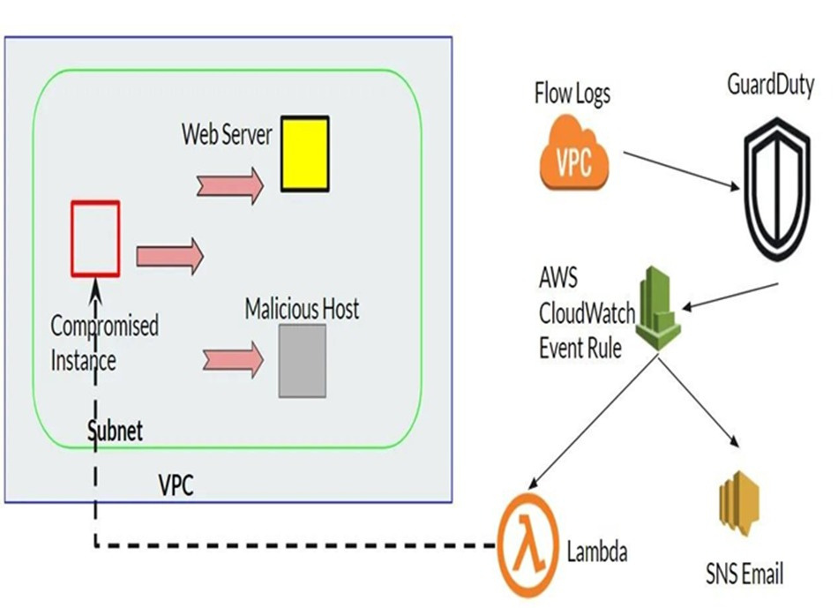
PG-Diploma in IT Infra-structure & System Security
Data Flow of the working system

Slide 6
PG-Diploma in IT Infra-structure & System Security
Implementation and Outputs
Enable GuardDuty
Create EC2 Instances
Set Up CloudWatch Event Rule
Remediation Process
AWS Service
GuardDuty
EC2
CloudWatch
IAM
Lambda
SNS

Slide 7
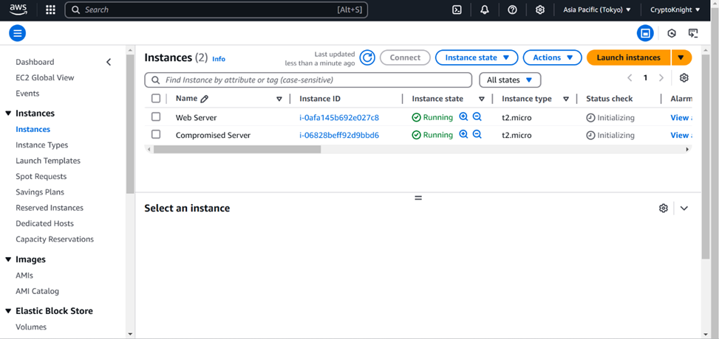
PG-Diploma in IT Infra-structure & System Security
Created EC2 instanceas web server and compromised server to demonstrate an attack scenario in network.

Slide 8
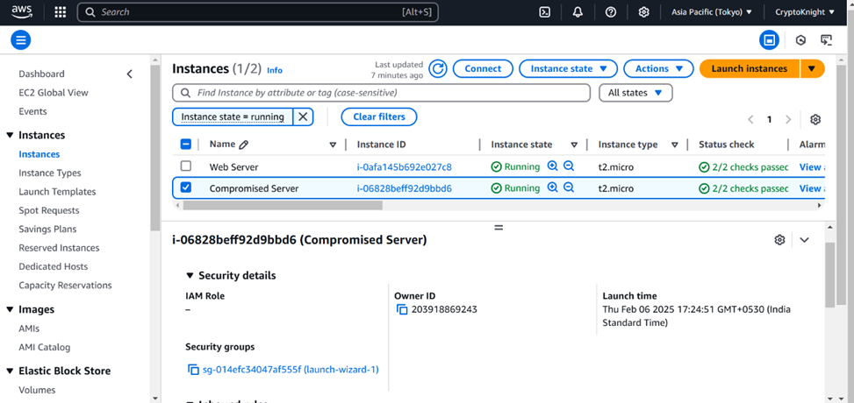
PG-Diploma in IT Infra-structure & System Security
Security group of a compromised machine.

Slide 9
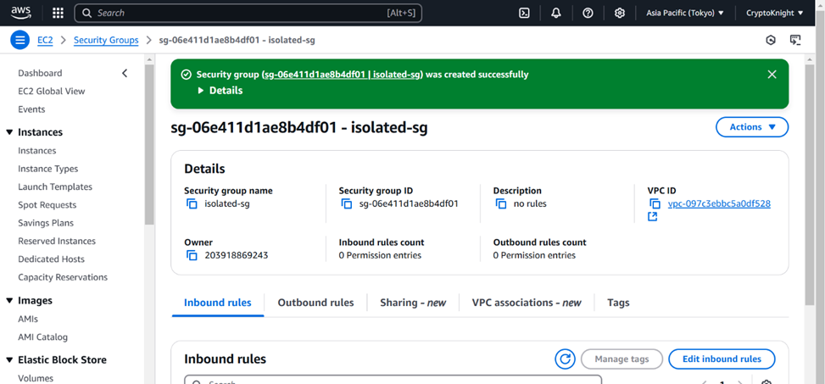

PG-Diploma in IT Infra-structure & System Security
Created an isolated securitygroup to isolated compromised machine.

Slide 10
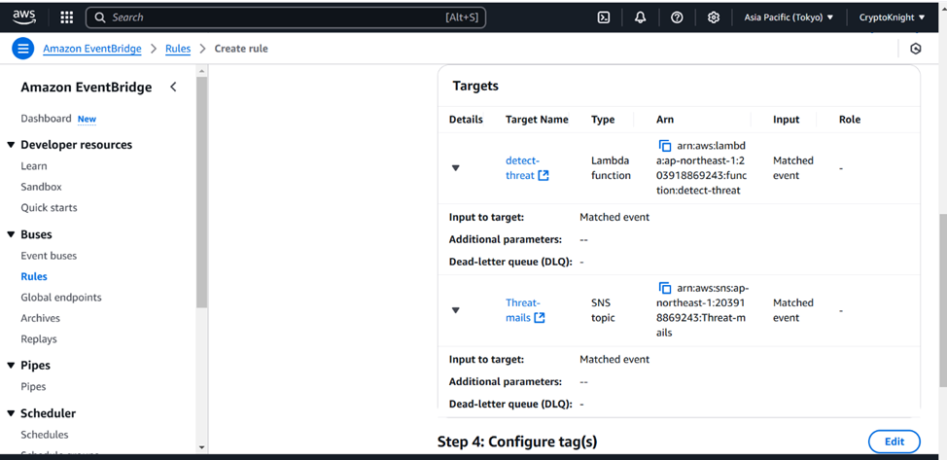
PG-Diploma in IT Infra-structure & System Security
Created CloudWatch rules for SNS and AWS Lambda function

Slide 11
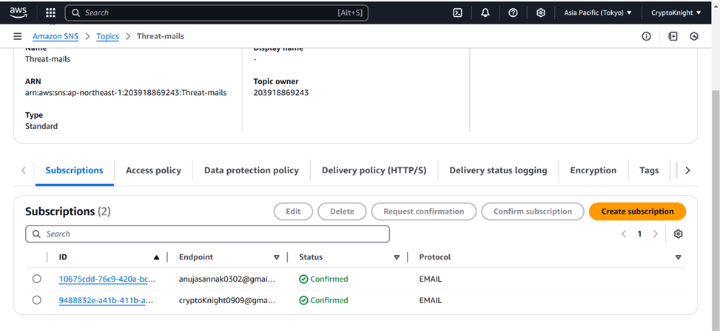
PG-Diploma in IT Infra-structure & System Security
Configured SNS for desiredendpoint mail ID

Slide 12
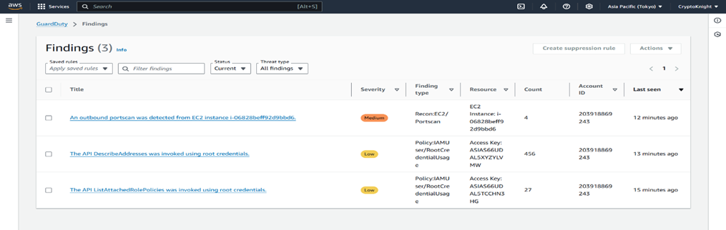
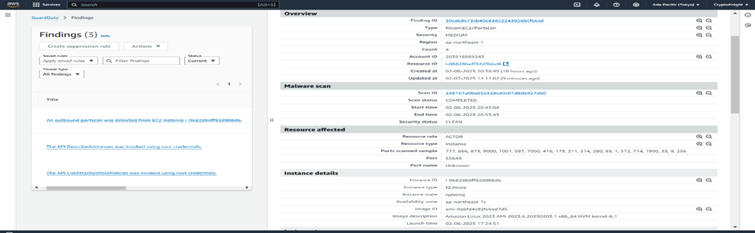
PG-Diploma in IT Infra-structure & System Security
Configured GuardDutyto scan malicious activities

Slide 13
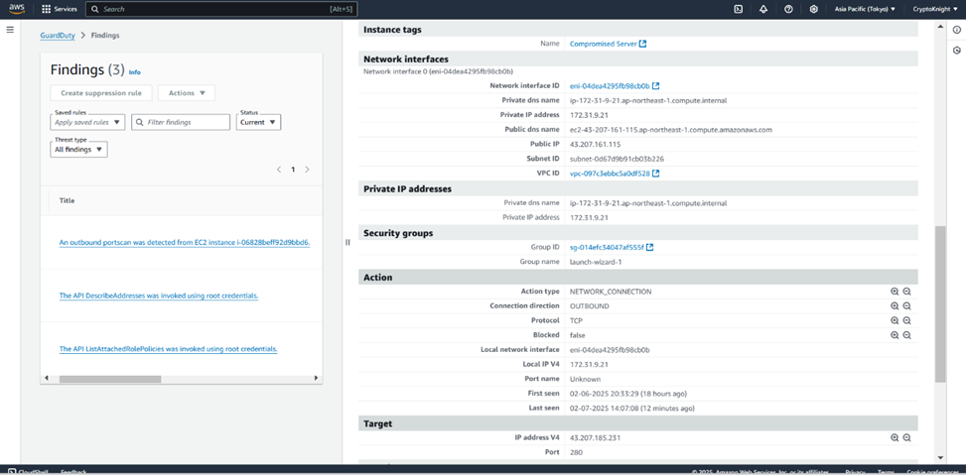
PG-Diploma in IT Infra-structure & System Security
Configured GuardDutyto scan malicious activities

Slide 14
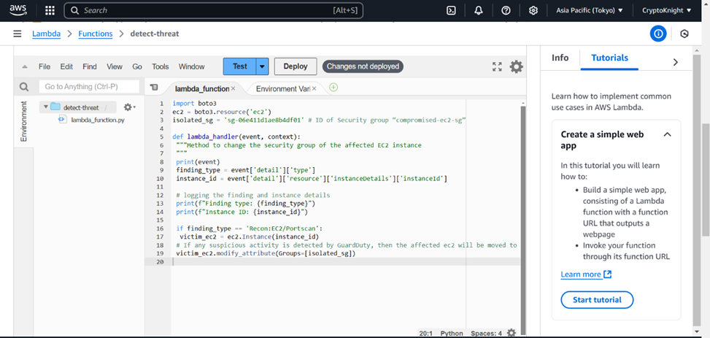
PG-Diploma in IT Infra-structure & System Security
Lambda functioncode to isolate a compromised instance by changingsecurity group

Slide 15
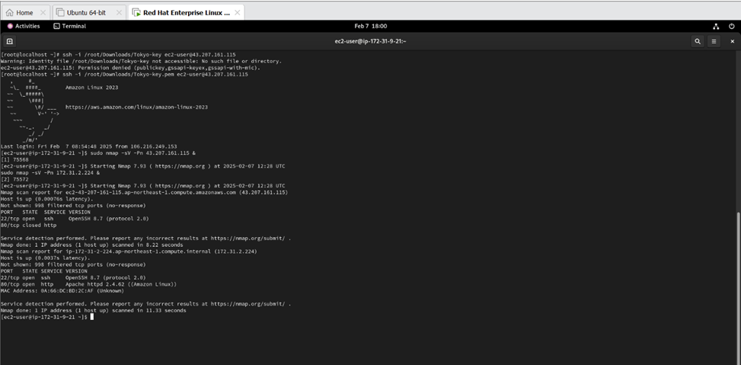
PG-Diploma in IT Infra-structure & System Security
Performing nmap to demonstrate portscan attack

Slide 16
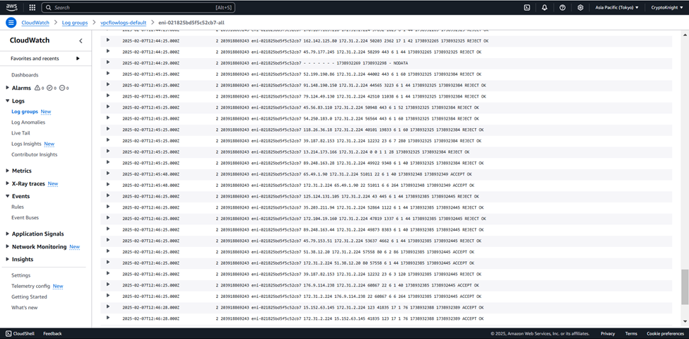
PG-Diploma in IT Infra-structure & System Security
CloudWatch logs after Attack is detected

Slide 17
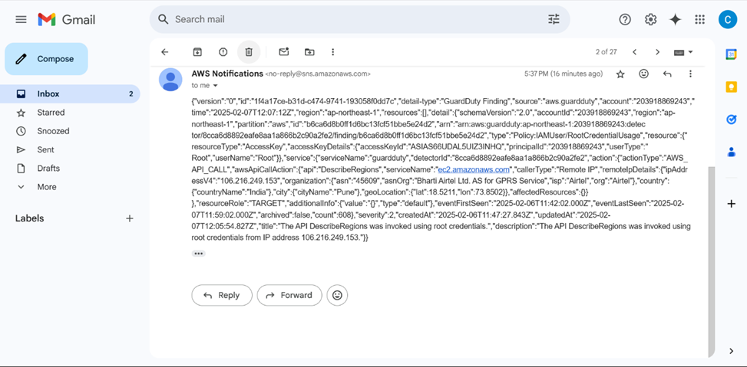
PG-Diploma in IT Infra-structure & System Security
SNSmail alert with JSON file

Slide 18
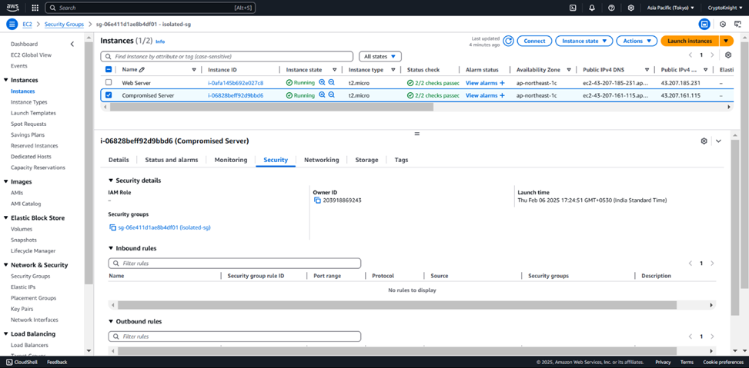
PG-Diploma in IT Infra-structure & System Security
After Attack is detectedthe security group of Compromised instances from attackeris performing portscan is changed to isolated group

Slide 19
PG-Diploma in IT Infra-structure & System Security
Conclusion
This AWS security framework integrates GuardDuty, CloudWatch, SNS, and Lambda to detect and respond to threats in real-time. By leveraging automated remediation via Lambda functions triggered by CloudWatch Events, it streamlines threat identification, alerting, and mitigation. The model detects risks like port scanning and unauthorized access, enforcing remediation actions such as isolating compromised instances. Continuous testing and compliance auditing ensure adaptability to evolving threats. This approach strengthens security posture, enhances incident response, and optimizes resource utilization, making it a robust blueprint for AWS security automation.

Slide 20
PG-Diploma in IT Infra-structure & System Security
References
1) https://aws.amazon.com/guardduty/
2) https://aws.amazon.com/guardduty/resources/
3) https://docs.aws.amazon.com/guardduty/latest/ug/guardduty_integrations.html
4) https://docs.amazonaws.cn/en_us/guardduty/latest/ug/infrastructure-security.html
5) https://docs.aws.amazon.com/AmazonCloudWatch/latest/monitoring/WhatIsCloudWa tch.html
6) https://docs.aws.amazon.com/awssupport/latest/user/cloudwatch-events-ta.html
7) https://docs.aws.amazon.com/sns/latest/dg/sns-create-topic.html
8) https://docs.aws.amazon.com/sns/latest/dg/sns-setting-up.html
9) https://medium.com/@roshan.kumar202/aws-threat-detection-and-automated-prevention-management-d7761eb42bab

Slide 21

PG-Diploma in IT Infra-structure & System Security
Thank You

